Slide 1


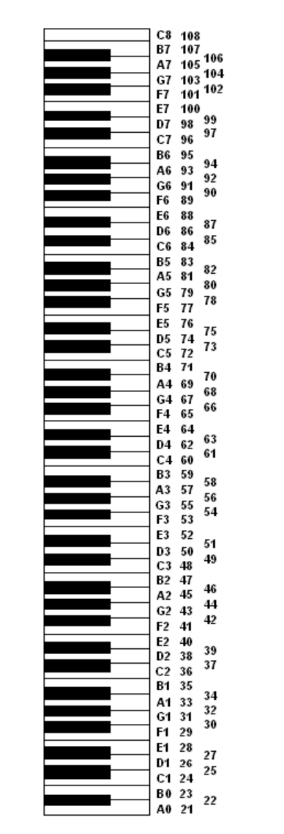
Alles bij elkaar

Slide 2
Alles bij elkaar
play 60
sleep 1
play :c4 ← toonladder = c,d,e,f,g,a,b,c
play_chord [:c4, :e4, :g4]
play_chord chord(:e4, :major) → major, minor…
play_pattern (scale :e4, :minor) → .reverse
play (scale :e4, :minor).choose
use_bpm 600
use_synth :hollow → saw, hoover, piano
2.times do
...
end
live_loop :mijnOneindigeLoop do
...
end
sample :bd_haus → :guit_em9 ...

Slide 3



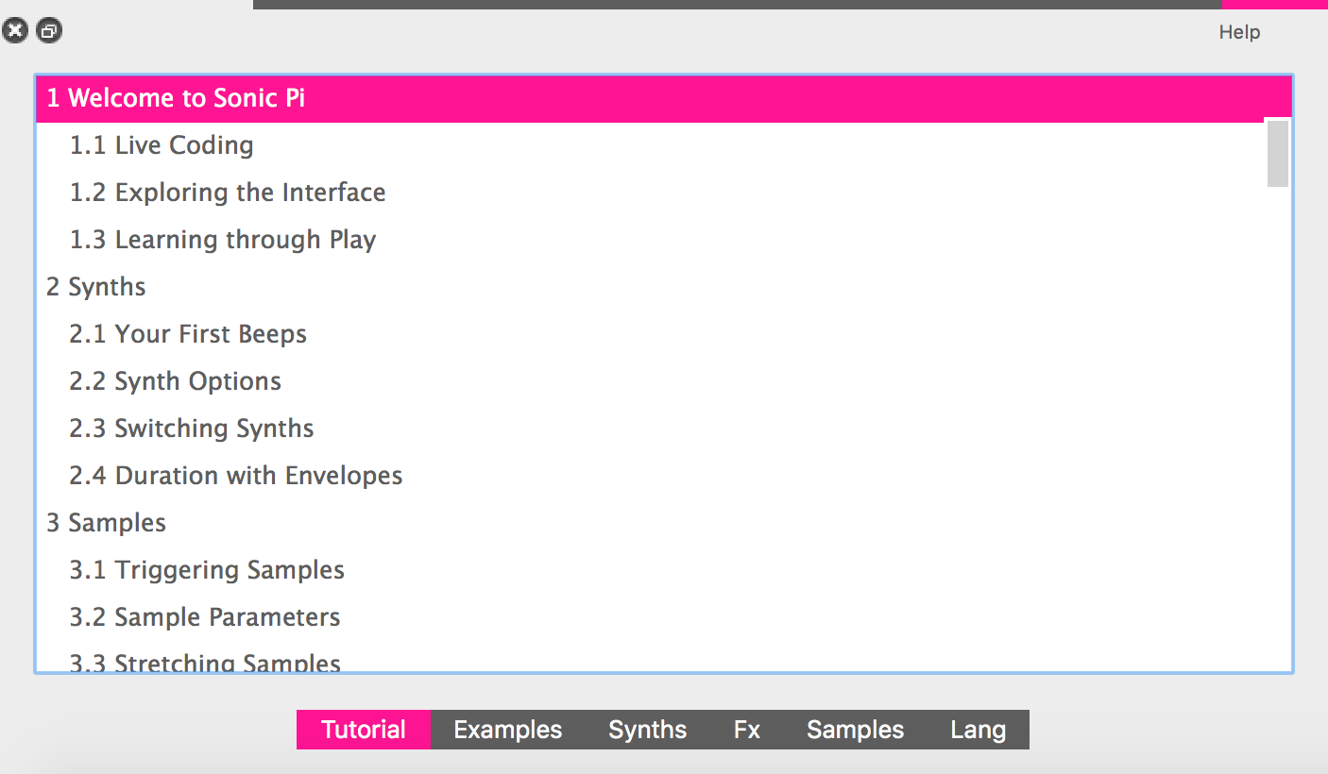
Alles bij elkaar
Sneltoetsen
ALT-R Run ALT-A Selecteer alles
ALT-S Stop ALT-C Copy
ALT-V Toevoegen
STRG-I Help voor huidige commando
Knoppen
Speel af Stop Opnemen
Bewaren Openen bestand
Verklein Tekst Vergroot
Handleiding
Voorbeelden
Effecten
Alle commando’s

Slide 4

Alles bij elkaar
use_synth
beep blade bnoise cnoise dark_ambience
dpulse dsaw dull_bell fm gnoise growl
hollow hoover
mod_beep mod_dsaw mod_fm chiplead chipbass chipnoise
mod_pulse mod_saw mod_sine mod_tri pule
noise piano pnoise pretty_bell prophet dtri pluck
saw sine square subpulse tb303 tri zawa
samples
:elec_triangle
:elec_snare
:elec_lo_snare
:elec_hi_snare
:elec_mid_snare
:elec_cymbal
:elec_soft_kick
:elec_filt_snare
:elec_fuzz_tom
:elec_chime
:elec_bong
:elec_twang
:elec_wood
:elec_pop
:elec_beep
:elec_blip
:elec_blip2
:elec_ping
:elec_bell
:elec_flip
:elec_tick
:elec_hollow_kick
:elec_twip
:elec_plip
:elec_blup
:bd_ada
:bd_pure
:bd_808
:bd_zum
:bd_gas
:bd_sone
:bd_haus
:bd_zome
:bd_boom
:bd_klub
:bd_fat
:bd_tek
:ambi_soft_buzz
:ambi_swoosh
:ambi_drone
:ambi_glass_hum
:ambi_glass_rub
:ambi_haunted_hum
:ambi_piano
:ambi_lunar_land
:ambi_dark_woosh
:ambi_choir
:bass_hit_c
:bass_hard_c
:bass_thick_c
:bass_drop_c
:bass_woodsy_c
:bass_voxy_c
:bass_voxy_hit_c
:bass_dnb_f
:drum_heavy_kick
:drum_tom_mid_soft
:drum_tom_mid_hard
:drum_tom_lo_soft
:drum_tom_lo_hard
:drum_tom_hi_soft
:drum_tom_hi_hard
:drum_splash_soft
:drum_splash_hard
:drum_snare_soft
:drum_snare_hard
:drum_cymbal_soft
:drum_cymbal_hard
:drum_cymbal_open
:drum_cymbal_closed
:drum_cymbal_pedal
:drum_bass_soft
:drum_bass_hard
:sn_dub
:sn_dolf
:sn_zome
:loop_industrial
:loop_compus
:loop_amen
:loop_amen_full
:loop_garzul
:loop_mika
:loop_breakbeat
:ambi_soft_buzz
:ambi_swoosh
:ambi_drone
:ambi_glass_hum
:ambi_glass_rub
:ambi_haunted_hum
:ambi_piano
:ambi_lunar_land
:ambi_dark_woosh
:ambi_choir
:drum_cowbell
:drum_roll
:misc_cros
:misc_cineboom
:perc_swash
:perc_till
:loop_safari
:loop_tabla
:misc_burp
:perc_bell
:perc_snap
:perc_snap2
:guit_harmonics
:guit_e_fifths
:guit_e_slide
:guit_em9

